Slide 1
College Graduation rates vs community size
Is there a correlation between community size and graduation rates?
By Brandon Van Nice

Slide 2
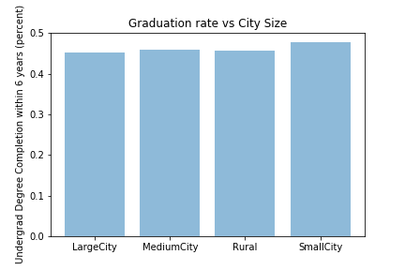
Graduation Rates by City Size
Observations:
How low the average graduation is per city size. It seems surprising that average graduation rates at 6 years are less than 50%.
Small Cities appear to have highest rate of graduation.
Limitations:
Data could be imperfect and skew to one of the categorical sizes.

Slide 3
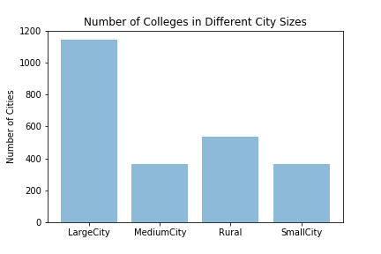
Number of Cities per category
Observations:
There are many more Colleges in Large Cities than any other size category.
Limitation:
Perhaps could have adjusted how cities were divided into different categories.

